Slide 1
AIR Background Tables
TIGERRISK PARTNERS

Slide 2
AIR Background Tables
01.
Intro to Background Tables
CEDE tables
LOSS tables
Reference Tables
Practice

Slide 3
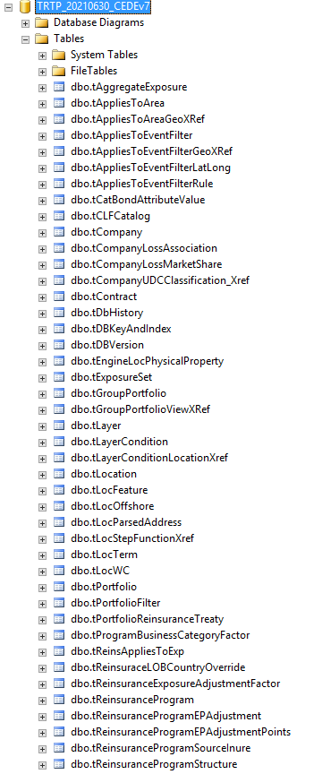
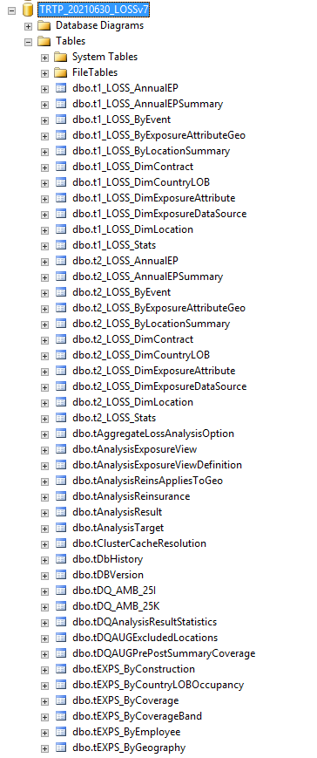
What are the “background tables”?
CEDE = Exposure Data; LOSS = Result Data
When you import your contract and location data into an CEDE, the data gets stored in various tables in the model’s SQL structure
Each model vendor has their own “database schema”
Tables contain a combination of user supplied data and model generated data
Models generate their own unique identifiers for specific contracts / locations / loss results / etc that can be used to tie across tables
tSIDControl Table – have largest ID numbers are where they are located

Slide 4
Key CEDE Tables
tExposureSet – highest Level Summary of Data Set
tContract – Contract Level Summary
tLayer – Policy Terms summary
tLayerCondition – Extended Policy Terms
tLocation – Basic Location Information
tLocFeature – Secondary Location Information
tLocTerm – Location Level Terms
ContractSID
LayerSID
tContract
tLayer
tLayerCondition
ExposureSetSID
tExposureSet
ContractSID
Potential Pitfall: Tables do not always link 1-1, be careful to not double count risks or policies
ExposureSetSID
LocationSID
tLocation
tLocTerm
LocationSID
tLocFeature

Slide 5
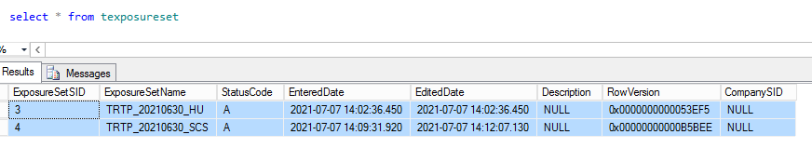
CEDE Tables – Exposure Set, Contract, Layer
NOTE: When trying to isolate exposures based on the Data Set they are in, join your exposures back to the tExposureSet table using the ExposureSetSID
When you import a data set, it gets saved in the tExposureSet table
ExposureSetName does not necessarily correspond to interface ExposureView
The ExposureSetSID field is key to linking to other data tables (e.g. tContract)
tContract contains Contract/Policy Overview with Contract Perils and LOB
tLayer links to tContract via ContractSID and contains Policy Level Terms like Premium, Blanket Limit, Policy Attachment
tLayerConditions links to tLayer (not always used) and limits what perils terms apply to, contains sublimit information

Slide 6
CEDE Tables – Location Information
NOTE: Tables have USERDefined Fields that can be used to create flags to filter data for more complex projects
Location Identifiers: LocationSID (AIR generated), LocationID (Imported), LocationName (Imported)
tLocation Table:
Exposure Identifiers: LocationSID, ContractSID, ExposureSetSID, LocationID, LocationName
Table information: Primary risk characteristics, Address/ GeoCode Information
tLocFeatureTable:
Exposure Identifiers: LocationSID
Table information: Secondary risk characteristics
Location level coverage information (coverage A/B/C/D, location deductibles, etc)
tLocTerm tables:
Exposure Identifiers: LoctermSID, LocationSID, ContractSID
Table information: Location level coverage information (coverage A/B/C/D, location deductibles, etc)
Each Location can have different peril specific coverage term

Slide 7
CEDE Tables – Profiling Examples
In SQL!

Slide 8
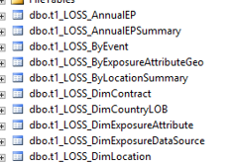
LOSS Tables – Identifying Analyses
Similar to identifying a data set, we need to be able to filter on an analysis
Identify which analysis you are looking at using the tAnalysisResult table
Can use the ResultSID to pull from the correct loss tables
Results are organized based on level Analysis Number and then level of event detail and level of AAL detail
Dim tables contain exposure level descriptions
tLossAnalysisOption table contains information on perils run. Good to confirm you ran what you think you ran.
tLossAnalysisPerilSetULOBOption stores Storm Surge option and Precipitation Flood Option Percentages
dbo.tX_LOSS_byXXXX… tables contain loss values by options ran
dbo.tX_LOSS_DimXXXX…. tables link to loss tables to option definitions (eg LOB names)

Slide 9
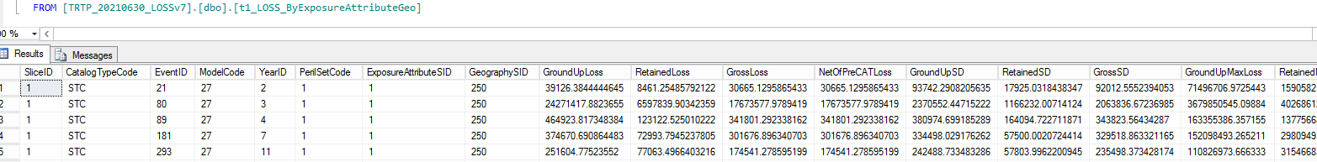
LOSS Tables– by Event
Potential Pitfall: Not pulling the “STC” only catalog ELT
AIR runs 10K or 50K simulations
By Exposure Attributes tables are By Event
CatalogTypeCode:
“STC” Stochastic Event Set – use for ELT pulls
“HIST” Historical Event Set – use for “as if” results from historical storms
“RDS” Realistic Disaster Scenario Event Set – used for Lloyds and other reporting entities
EventID: Peril Model Specific Event Number
ModelCode: Peril Model
YearID: Simulated Year
ExposureAttributeSID: Links to DimExposureAttribute Table to return Selected Attribute
GeographySID: Links to AIRGeography.dbo.tGeography table to return regional level
Loss output at a Ground Up, Retained, Gross or Net of PreCat based on selected runs
Concatenate to get unique “EventID” Identifier [ModelCode*10000000+EventID]

Slide 10
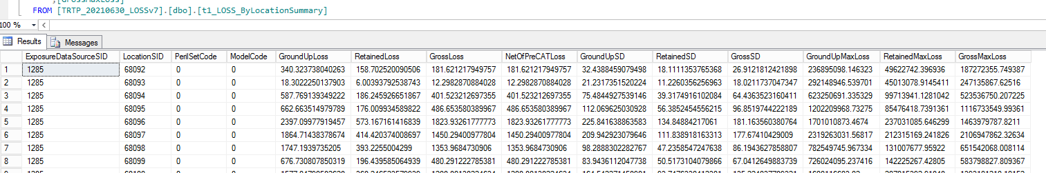
LOSS Tables– by AAL
By AAL Table is Location Only
Can create other AAL tables from by Event tables by grouping by Desired Attribute and dividing by number of event simulations

Slide 11
LOSS Tables – Loss Examples
In SQL!

Slide 12
Other Useful Back Tables
AIRReference
Contains descriptors of various internal AIR codes
tPerilSetCode – describes the peril an exposure is coded for
tGeoMatchLevel – describes geocoding flag meetings
tOccupancy – Occupancy code descriptions
Look up any qualitative description for nearly any code
AIRGeography
tGeography contains reference for GeographySIDs
AIREvents
Contains event descriptions by model code tables
AIREvents_Hist
Contains references to modeled historical events by model code tables

Slide 13

Questions?

Slide 14


